Slide 1
CS-1204
Object-Oriented Programming
(3+1)
Lecture
By
Engr. Muhammad Awais
Prepared by : Engr. M.Awais

Slide 2
Special Features in C++
Prepared by : Engr. M.Awais
Notes:
M.Awais

Slide 3
Objectives
By the end of this lecture, students will be able to:
  Understand and apply friend functions to allow controlled access to private/protected members across classes.
  Implement static data members and static member functions to share data and behavior across all objects of a class.
  Define and use pure abstract functions to create abstract classes and enforce function overriding in derived classes.
Prepared by : Engr. M.Awais
Notes:
M.Awais

Slide 4
Friend Functions
Friend functions allow external functions or classes to access private and protected members of a class.
Normally, private and protected members cannot be accessed from outside the class.
A friend function provides controlled access to these members.
  A friend function is not a member of the class.
  It can access private and protected members.
  It must be declared inside the class using the keyword friend
Prepared by : Engr. M.Awais
Notes:
M.Awais

Slide 5
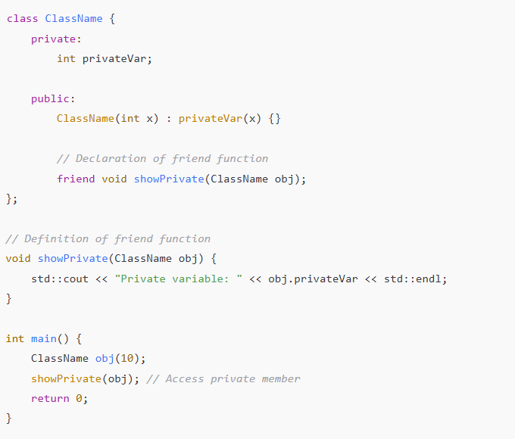
Syntax
Prepared by : Engr. M.Awais
Notes:
M.Awais

Slide 6
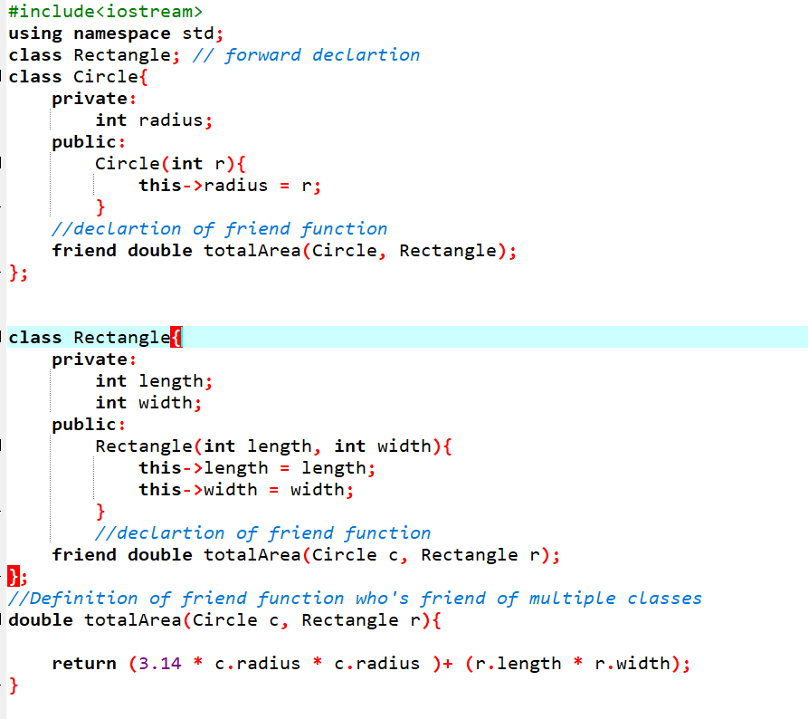
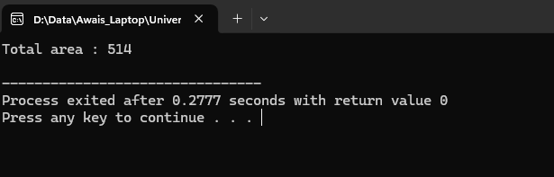
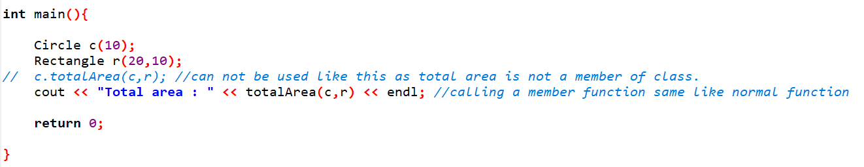
Example
Prepared by : Engr. M.Awais
Notes:
M.Awais

Slide 7
Key Points About Friend Functions
Not a Member Function: Friend functions are external to the class.
Declared with friend keyword: Without friend, the function cannot access private/protected members.
Can Access Private/Protected Members: That’s the main purpose.
No this pointer: Friend functions are not members, so they don’t have a this pointer.
Can be Called Normally: You call it like a regular function, not through an object.
Can be a Friend to Multiple Classes: A friend function can access members of more than one class if declared in multiple classes.
Prepared by : Engr. M.Awais
Notes:
M.Awais

Slide 8
Static Members
In C++, static members are shared by all objects of a class. There are two types:
  Static Data Members (Variables).
  Static Member Functions
  Key points:
  A static member belongs to the class itself, not to any particular object.
  All objects of the class share the same static member.
  Static members exist even if no objects of the class are created.
  Can be accessed using the class name: ClassName::staticMember.
Prepared by : Engr. M.Awais
Notes:
M.Awais

Slide 9
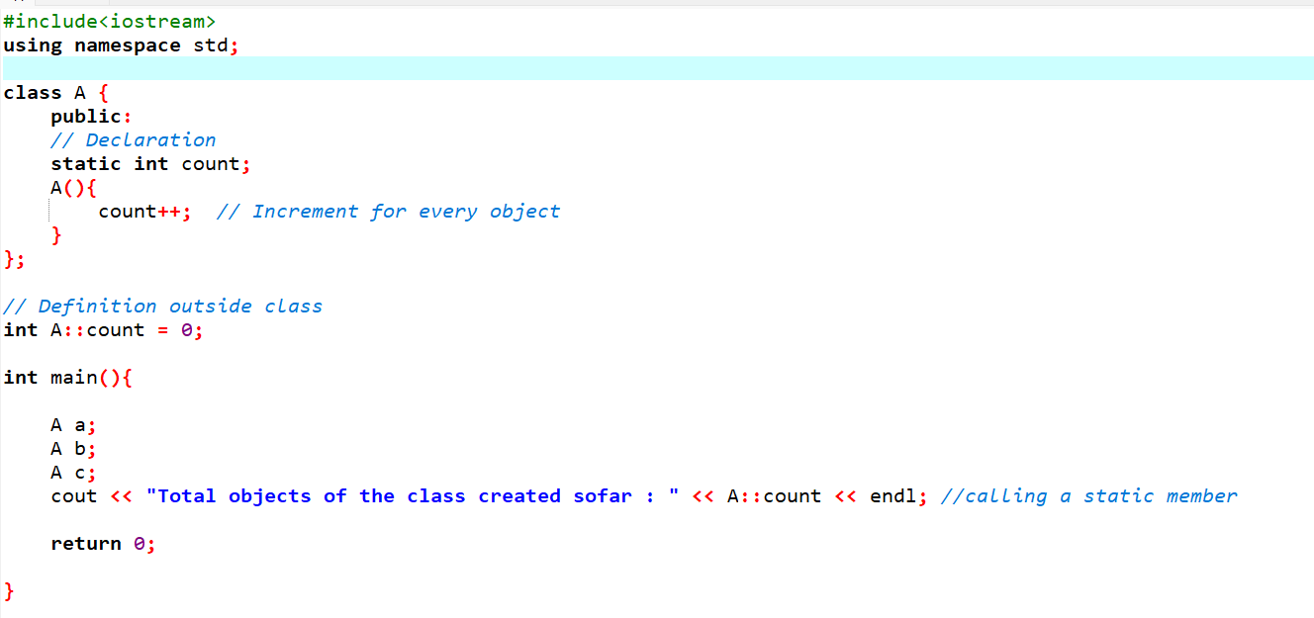
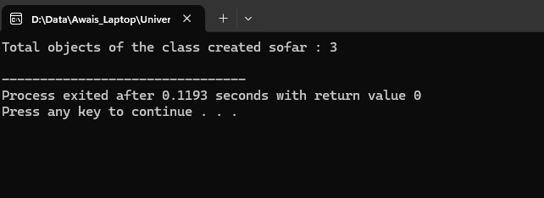
Example of Static Data Members
Prepared by : Engr. M.Awais
Notes:
M.Awais

Slide 10
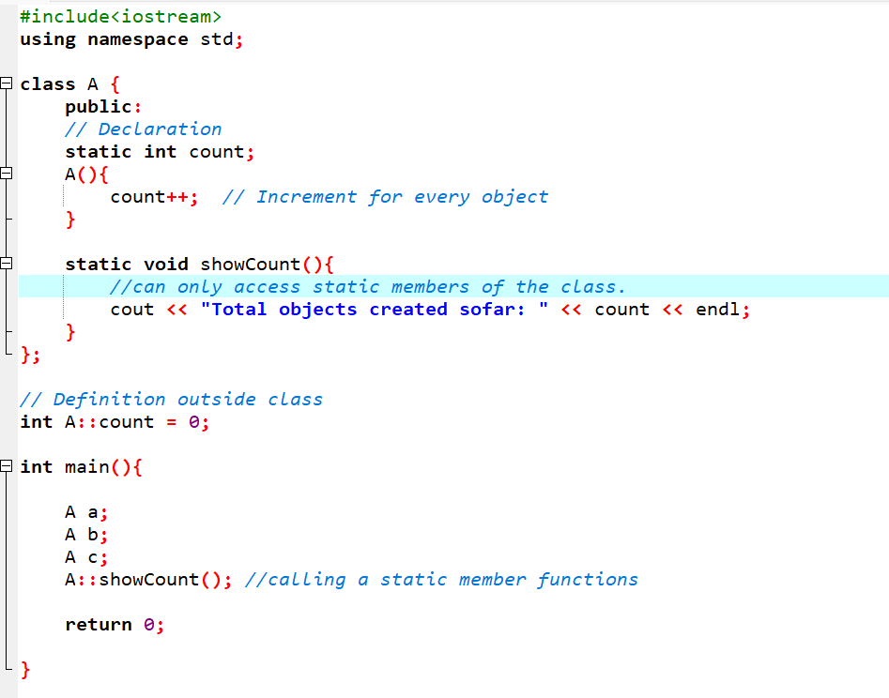
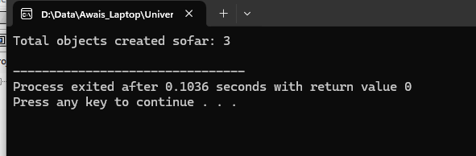
Example of Static Members Functions
Can only access static data member
Do not have this pointer.
Called using the class name.
Prepared by : Engr. M.Awais
Notes:
M.Awais

Slide 11
Pure Abstract Functions
A pure abstract function in C++ is a function that has no implementation in the base class and must be overridden by derived classes.
  Used to create abstract classes.
  Declared using = 0 syntax.
  Makes the class abstract, meaning you cannot create objects of that class.
  Derived class must override the function to become concrete.
  You can have multiple pure abstract functions in a class.
  Abstract classes can have normal functions and data members too.
Prepared by : Engr. M.Awais
Notes:
M.Awais

Slide 12
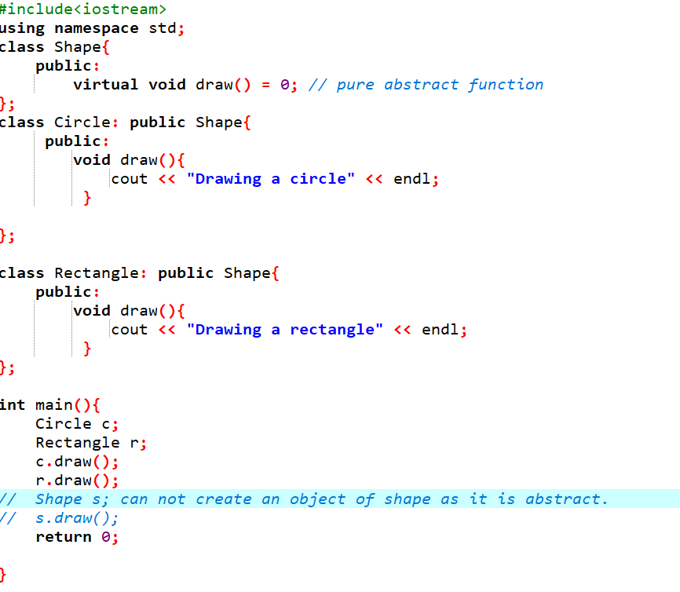
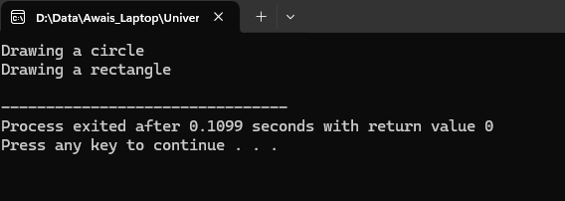
Example of Pure Abstract Function
Prepared by : Engr. M.Awais
Notes:
M.Awais

